Slide 1


DePaul Data Science Summer Academy
Educating Chicago Public High School Students about Data Science

Slide 2
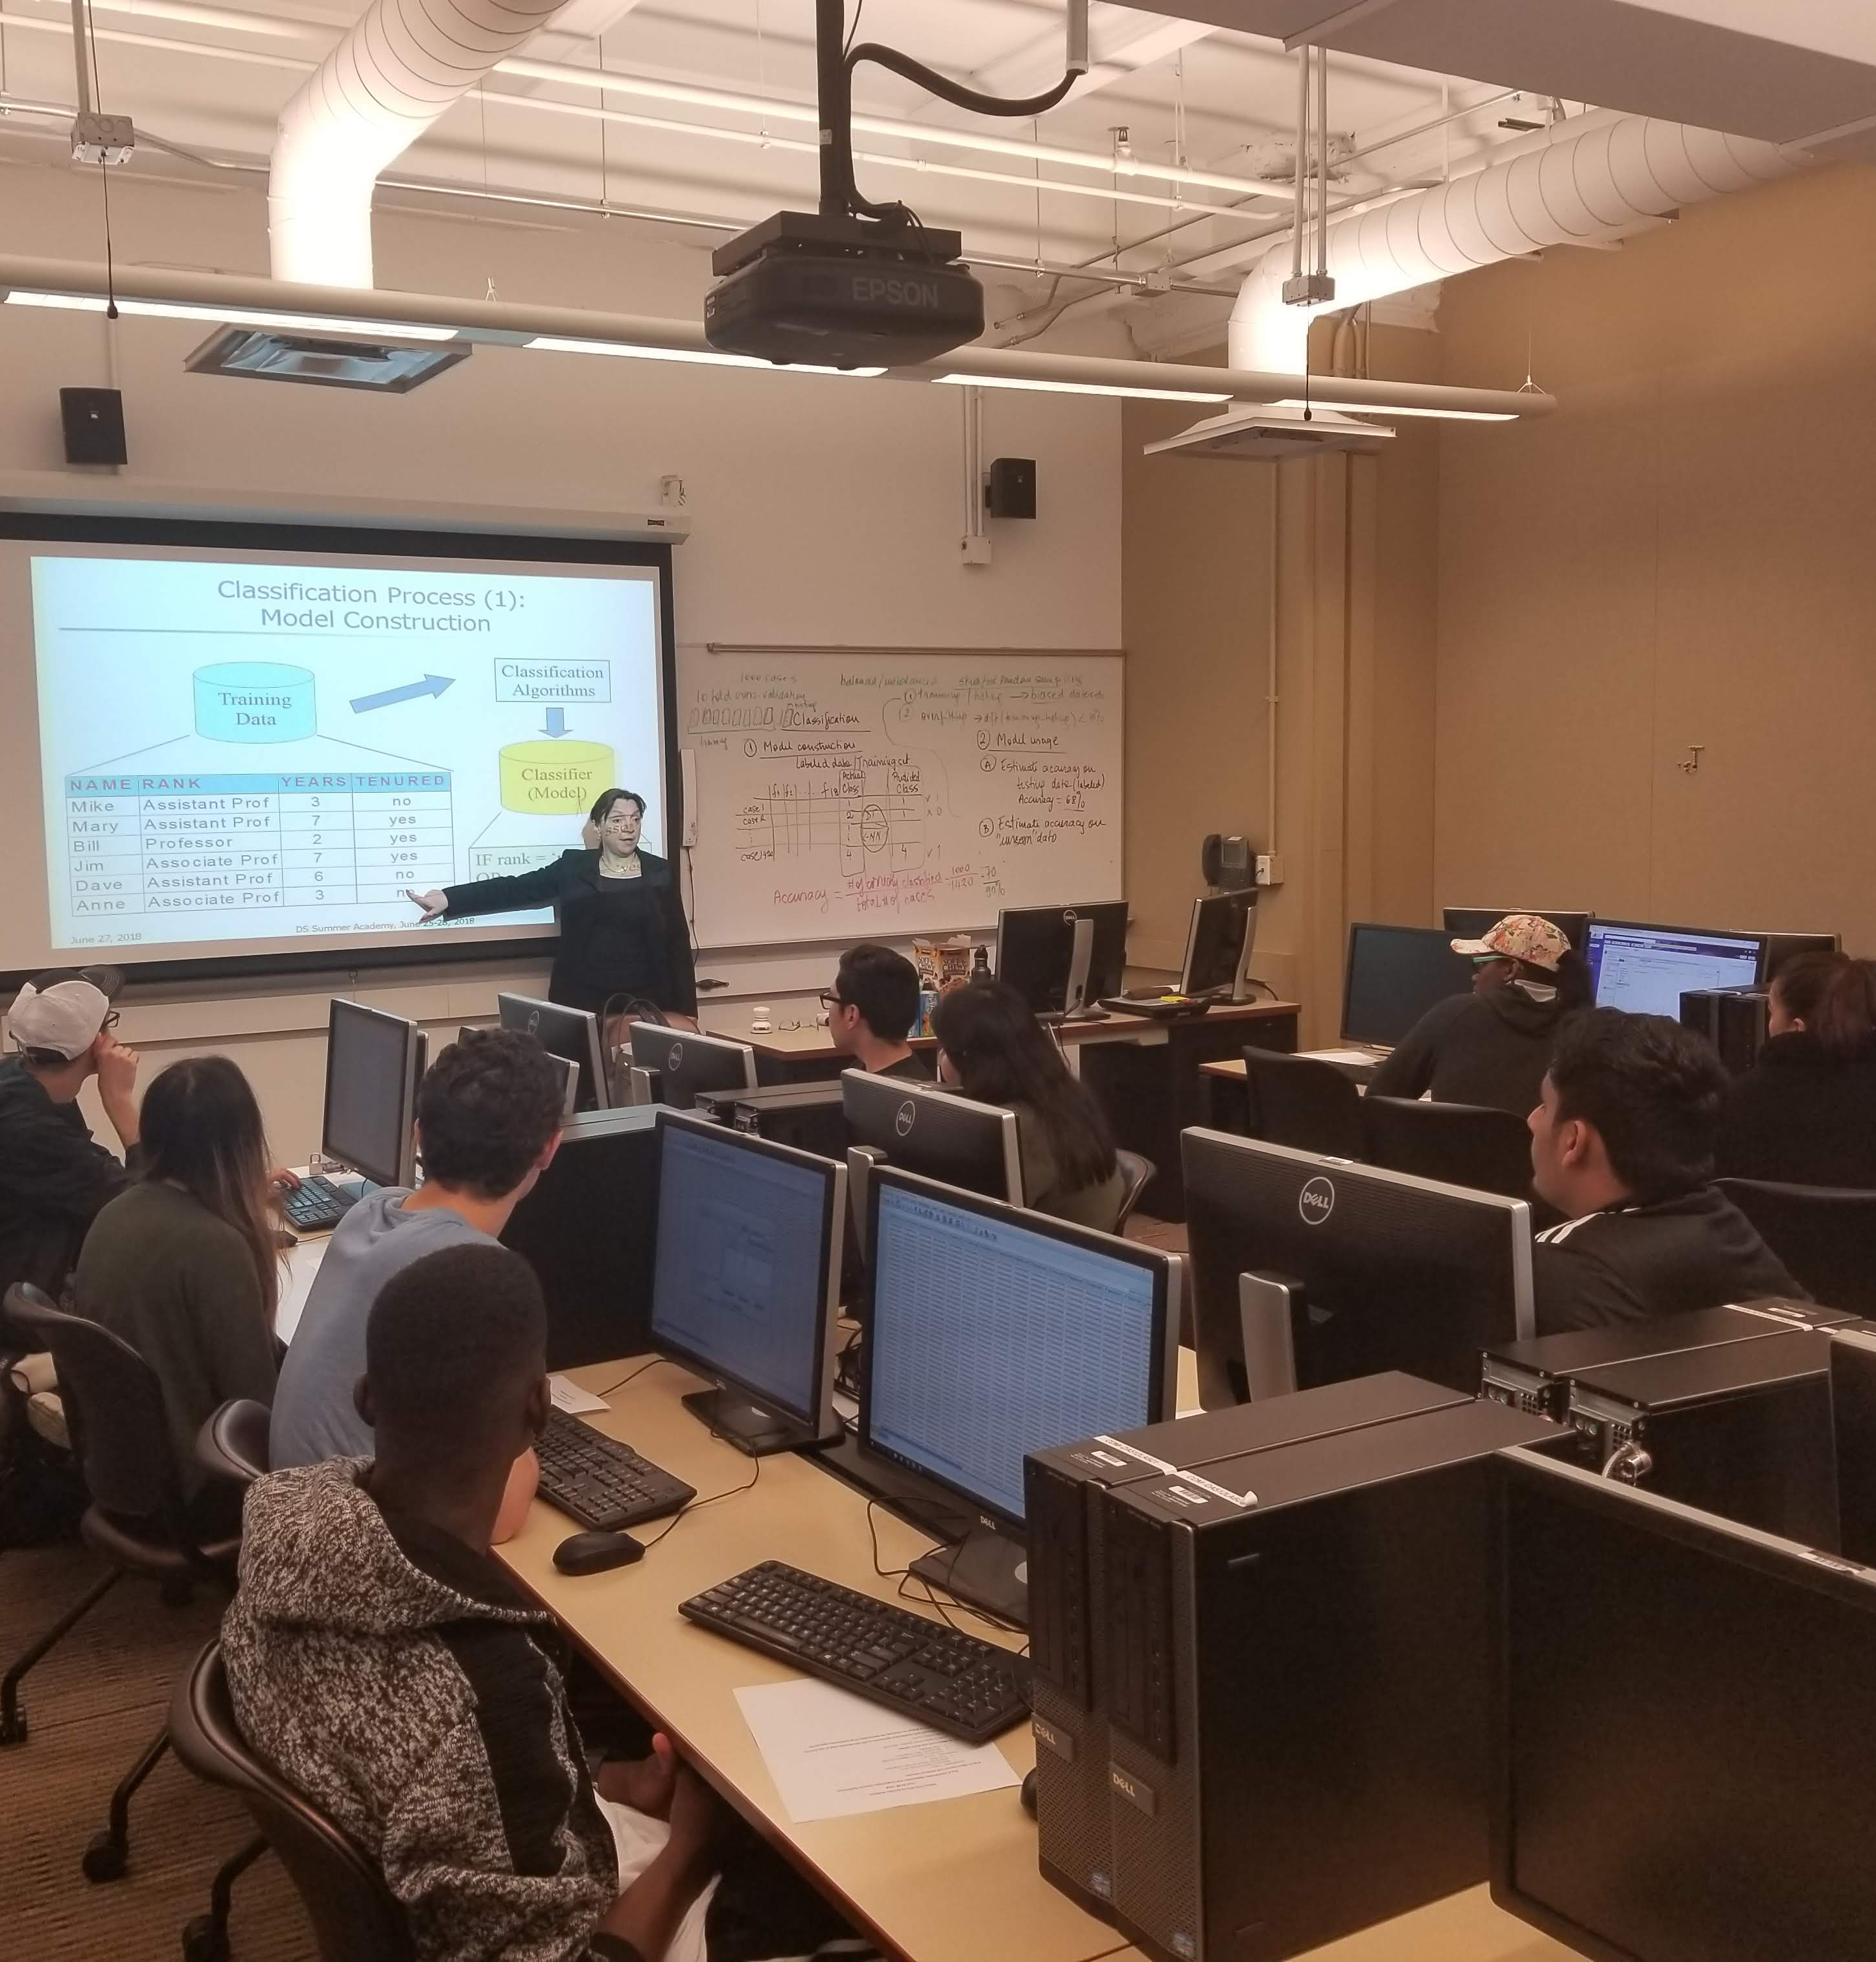
About Us
OBJECTIVES:
Get high school students (particularly from under-served communities) excited about pursuing data science in college and careers.
Teach basic data science concepts, tools & techniques with hands on applications for problems students can relate to.
Introduce students to the wide variety of domain applications and career possibilities in data science through guest speakers.
DePaul Center for Data Mining
& Predictive Analytics

Slide 3
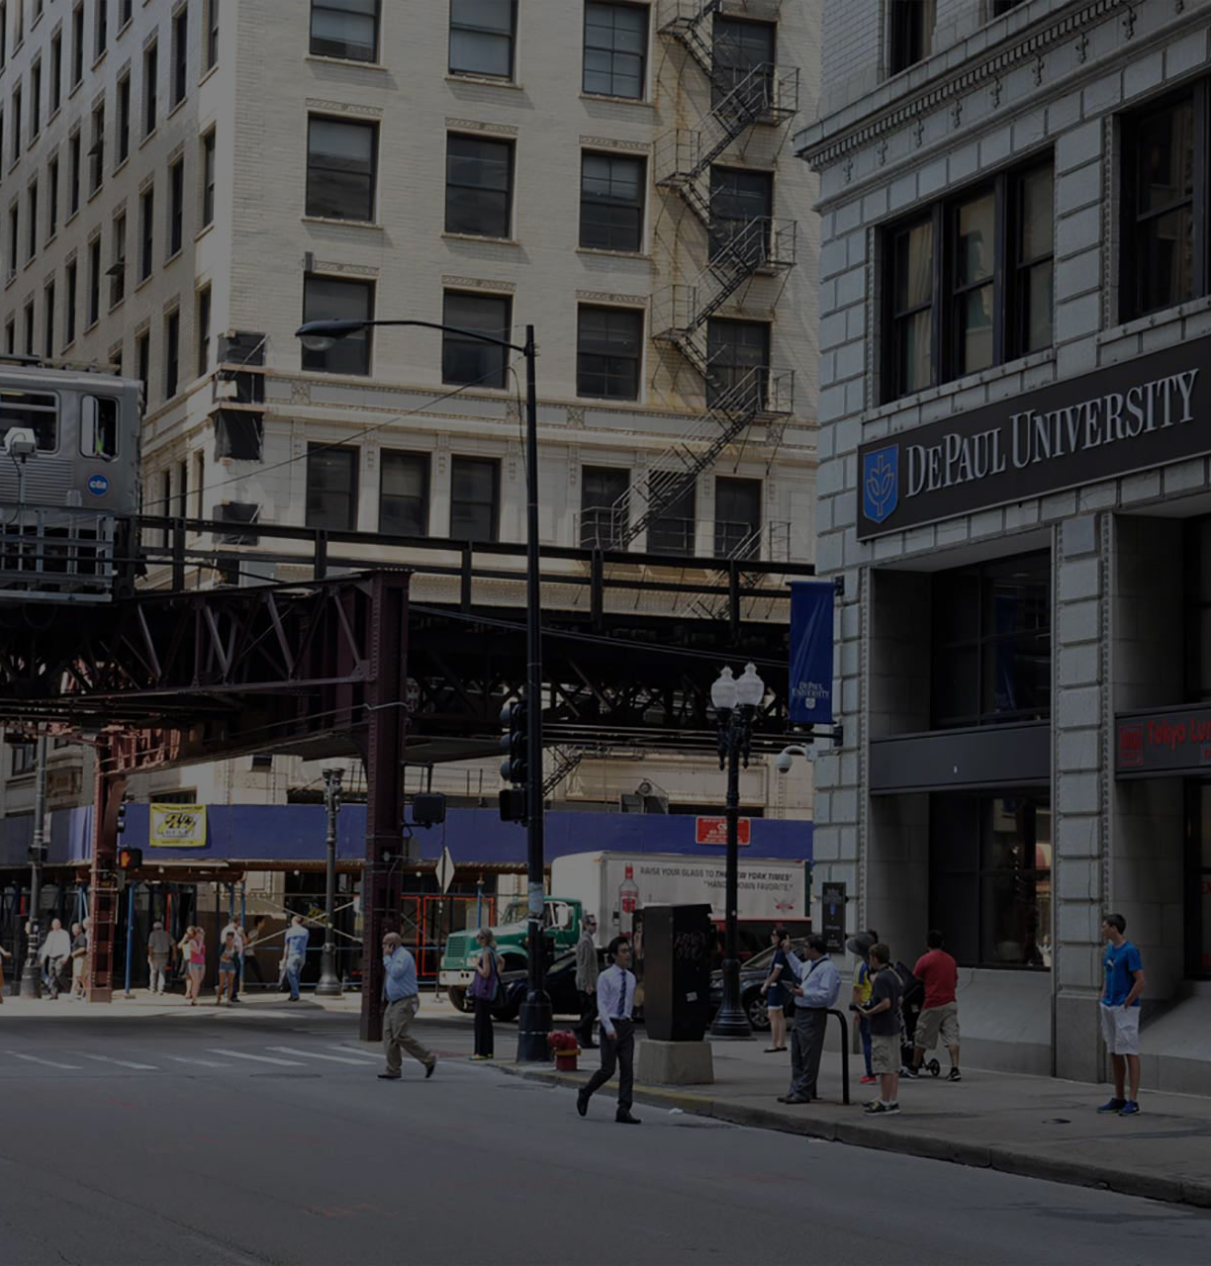
SPONSORS
Center for Data Mining and Predictive Analytics (DaMPA)
Advance research and practice in data science
Nurture the next generation of computer and data scientists through innovative programs
Build partnerships with industry and non-profit organizations
DePaul College of Computing and Digital Media (CDM)
SIGKDD and DaMPA

Slide 4
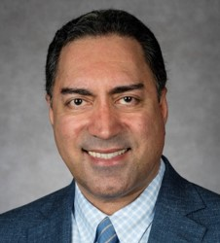
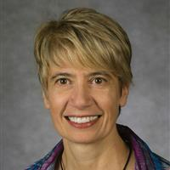

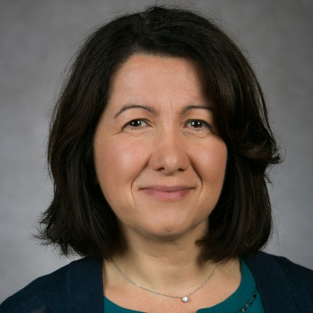
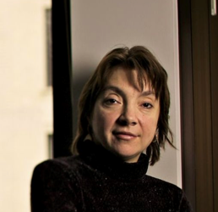
Team
Bamshad Mobasher
Professor, School of Computing
Director, Center for Web Intelligence
Lucia Dettori
Associate Dean, College of Computing
Liaison with CPS
Bamshad Mobasher
Daniela Raicu
Raffaella Settimi
Raffaella Settimi
Associate Dean, College of Computing
Lucia Dettori
Daniela Raicu
Professor, School of Computing
Director, Center for Data Mining and Predictive Analytics
Co-Director, Medical Informatics (MedIX) Laboratory

Slide 5
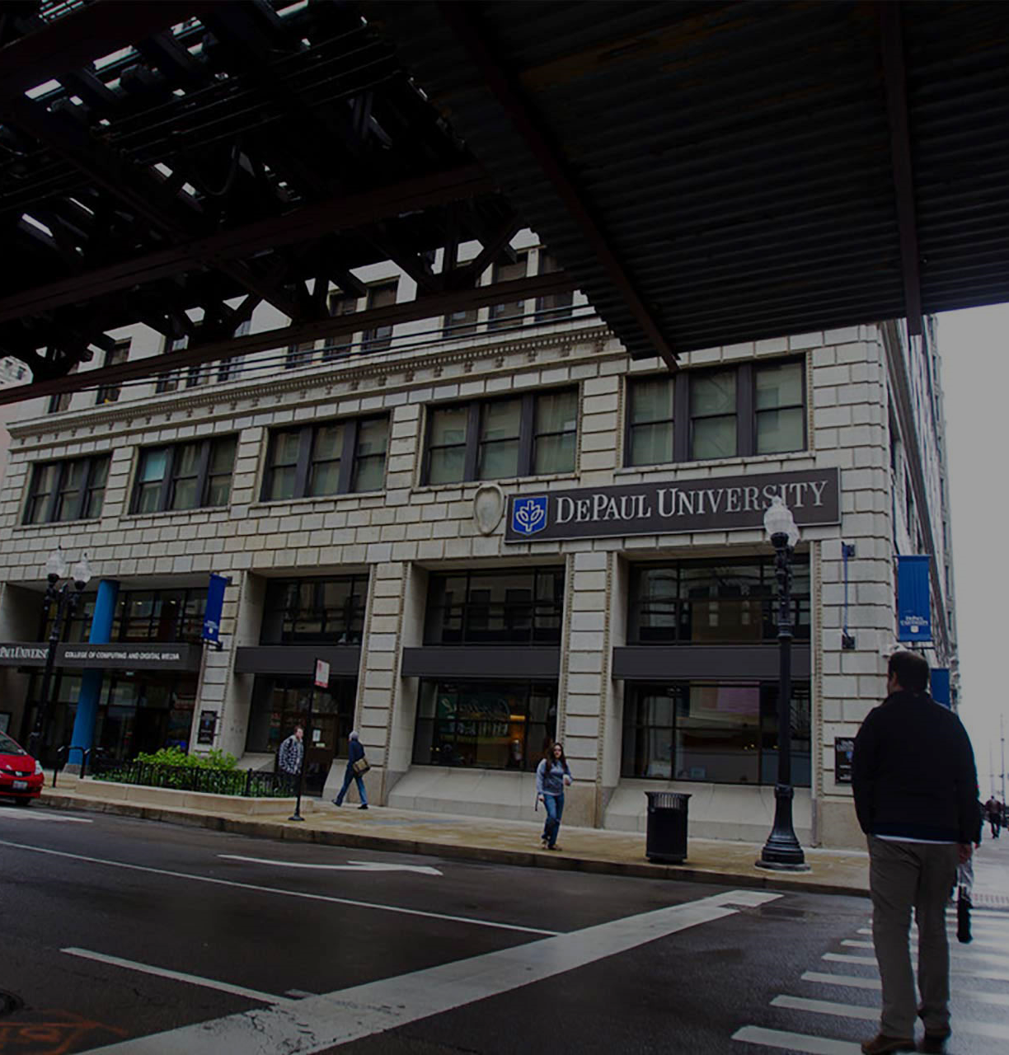
Recruitment
Specifically Targeted Chicago Public Schools
Reached out to CPS high school computer science teachers to share information about our program
Posted information on CPS online bulletin boards
173 applications for 15 spots were received

Slide 6
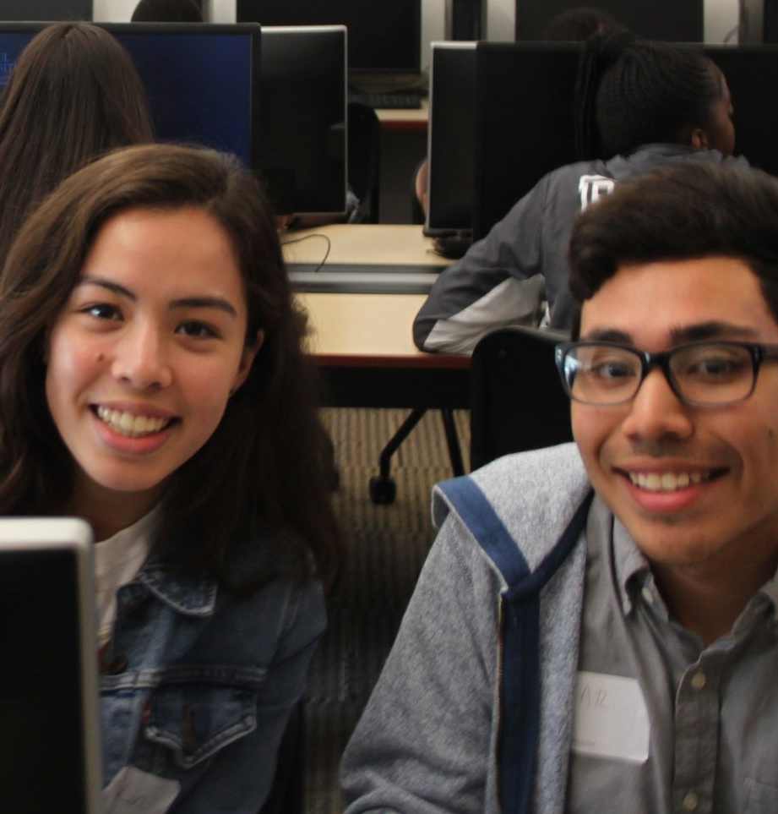
Diversity
SELECTION PROCESS
SCHOOL District Diversity
167 high schools in Chicago. Some among the best in the US and some are among the worst.
We selected candidates from a wide spectrum of school districts.
This ensured broad ethnic diversity as well as a wide range of economic backgrounds among students.
GENDER Diversity
DESIRE
Students were required to write a brief essay as to WHY they wanted to attend.
GPA
Majority of participants had a GPA over 3.5 (on 4.0 scale). A few with 3.0 GPAs were accepted based on their essays and to increase diversity of schools.
Ethnic, gender, school quality, desire

Slide 7
STUDENT DEMOGRAPHICS
Economic data was not gathered, however 78% of the CPS population are economically disadvantaged

Slide 8
CURRICULUM
Monday | Tuesday | Wednesday | Thursday | Friday
Intros & ABCs of Data Science | Data Exploration & Visualization | Classification Models (decision trees, KNN) & Image recognition | Cluster analysis & Segmentation; Recommender Systems | Student Group Presentations (5 groups)
Research project presentations by DePaul students | Tableau SPSS | Matlab SPSS | Python; Jupyter Notebook | Reception
June 25-29, 2018
9.30am to 3.30pm

Slide 9




INDUSTRY SPEAKERS

Slide 10
TOOLS & DATASETS
TOOLS
DATASETS
MATLAB
SPSS
PYTHON
TABLEAU
SLACK
SPOTIFY (Used for overall group projects)
DIVY (Chicago bike sharing) dataset
Human Activity Recognition dataset
ATT face recognition dataset (for images)

Slide 11

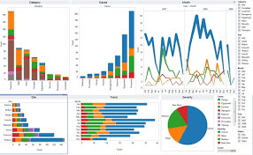
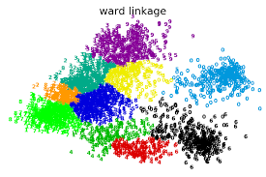
Tuesday: Data Exploration and Visualization
Focus on techniques to learn about the characteristics of data, identify general patterns and to visualize trends and patterns
Tools: SPSS and Tableau
Lab activity: Analyze Chicago Divvy bikes usage during the past year
Group project activity: Characterize the Spotify data set

Slide 12
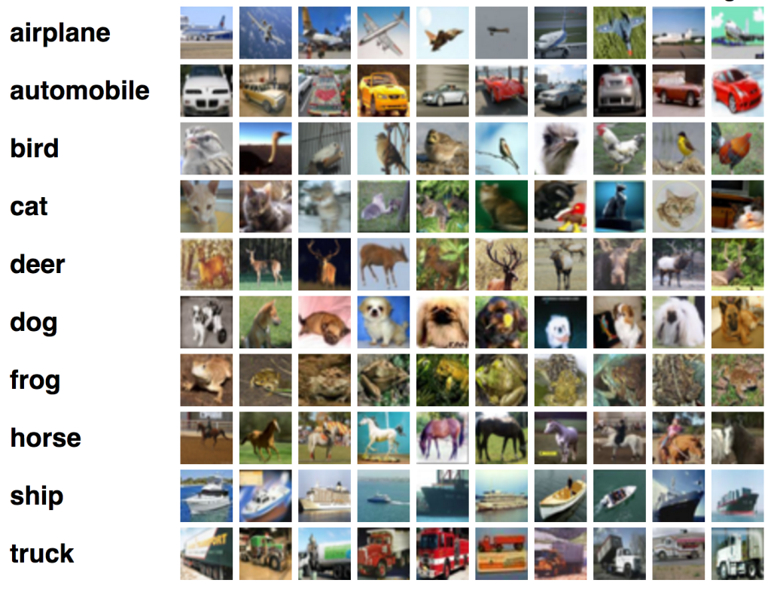
Wednesday: Classification and Image Recognition
Focus on discovering patterns in image and video data with applications to human activity recognition
Tools: SPSS and Matlab
Lab Activity: extracting pixel data for face recognition used in image classification
Group project activity: build classifier to Spotify songs into existing categories based on song features

Slide 13
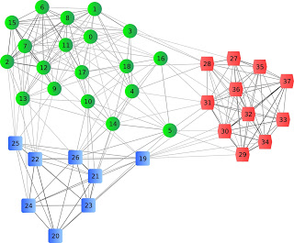
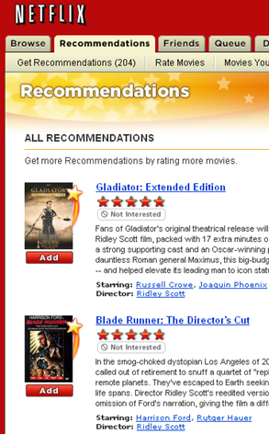
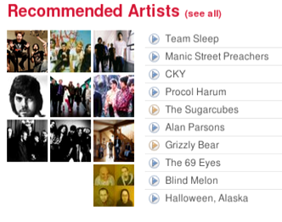
Thursday: Distance-based Methods and Clustering
Focus on applications in recommender systems & music playlist generation
Jupyter Notebooks, Python, pandas, scikit-learn
Lab activity using KNN for song recommendation; Kmeans clustering
Group project activity: performing cluster analysis and visualization on Spotify song data

Slide 14
STUDENT SURVEY RESULTS
BEFORE
AFTER
Strongly agree

Slide 15
STUDENT SURVEY RESULTS
BEFORE
AFTER
Strongly agree

Slide 16
POST-PROGRAM SURVEY RESULTS
I understand what it means to be a data scientist…what type of work they do.
I plan to keep exploring data science in my free time.

Slide 17
POST-PROGRAM SURVEY RESULTS
I understand when a classification model should be used (i.e. decision tree).
I understand when a distance-based model should be used (i.e. KNN).

Slide 18
POST-PROGRAM SURVEY RESULTS
I know how to create a data visualization to create a story.
I understand what clustering is used for.

Slide 19
SURVEY RESULTS – “I liked this camp” and “I learned a lot at this camp”

Slide 20
STUDENT COMMENTS
Great program! Wish it was 2 weeks!
All of the speakers [were my favorite], because they provided a perspective of someone who works in the field and taught us a lot of what they actually did.
I loved learning new applications and ways to analyze and visualize data.
Thank you for not dumbing it down!
It was fascinating to see how graphs could tell a story about data.

Slide 21
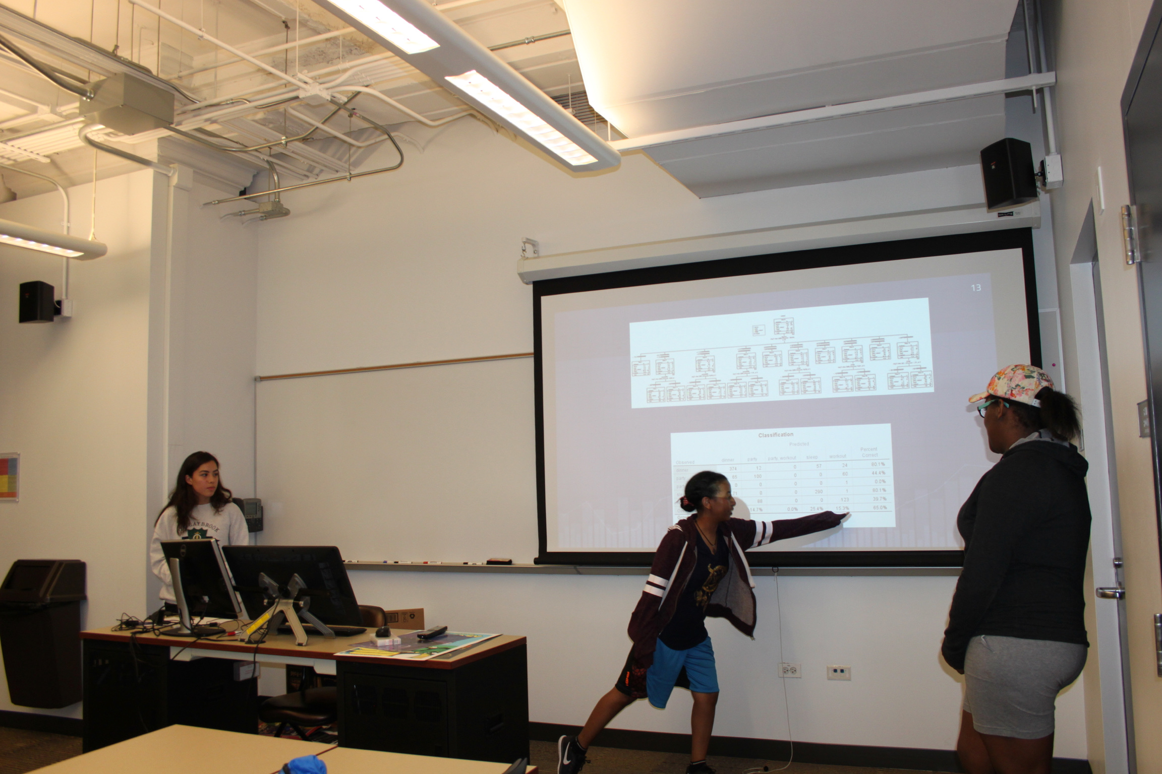
PLANS FOR FUTURE
Success of program and the strong demand demonstrates need for additional programs in the future. Especially to provide opportunities for students in economically disadvantaged communities.

Slide 22
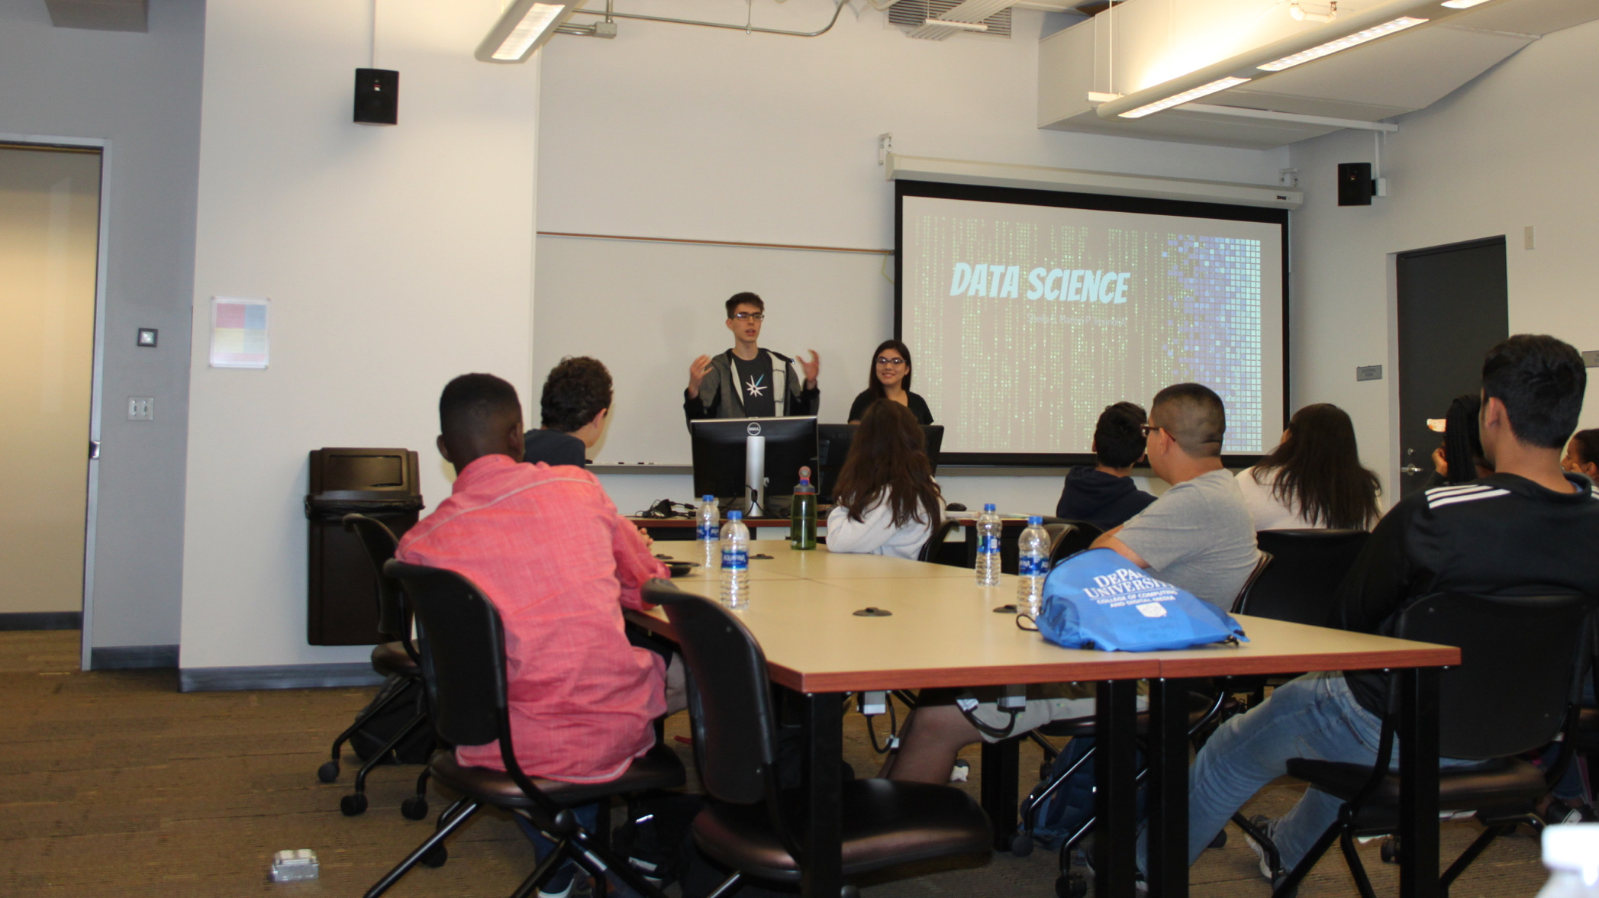
FUTURE PROGRAMS
More engagement from Chicago high school teachers in the design of the curriculum
Include other datasets for social good
Even more hands on activities in a variety of settings

Slide 23
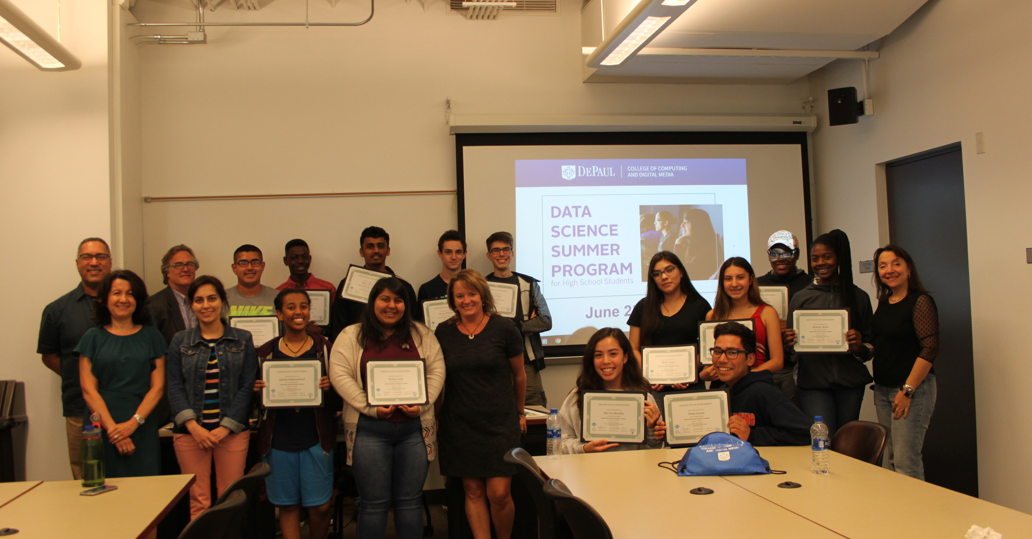
Large image
LAST DAY
https://ddssacademy.wordpress.com/

